Slide 1
BOATS DATA ANALYSIS
Mohammad Aris Darmawan

Slide 2
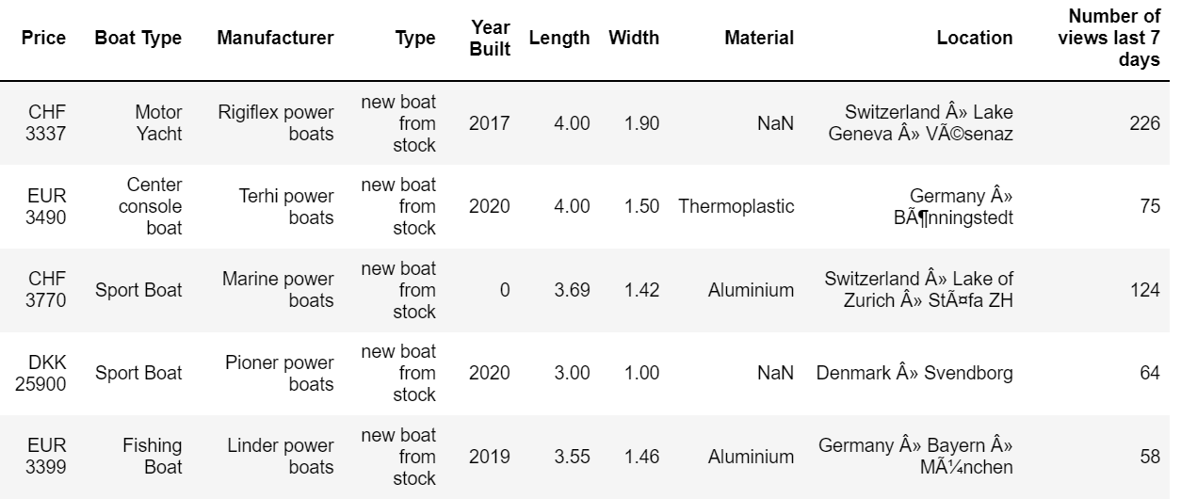
DATA OVERVIEW
Convert into EUR
Calculate size = length * width

Slide 3
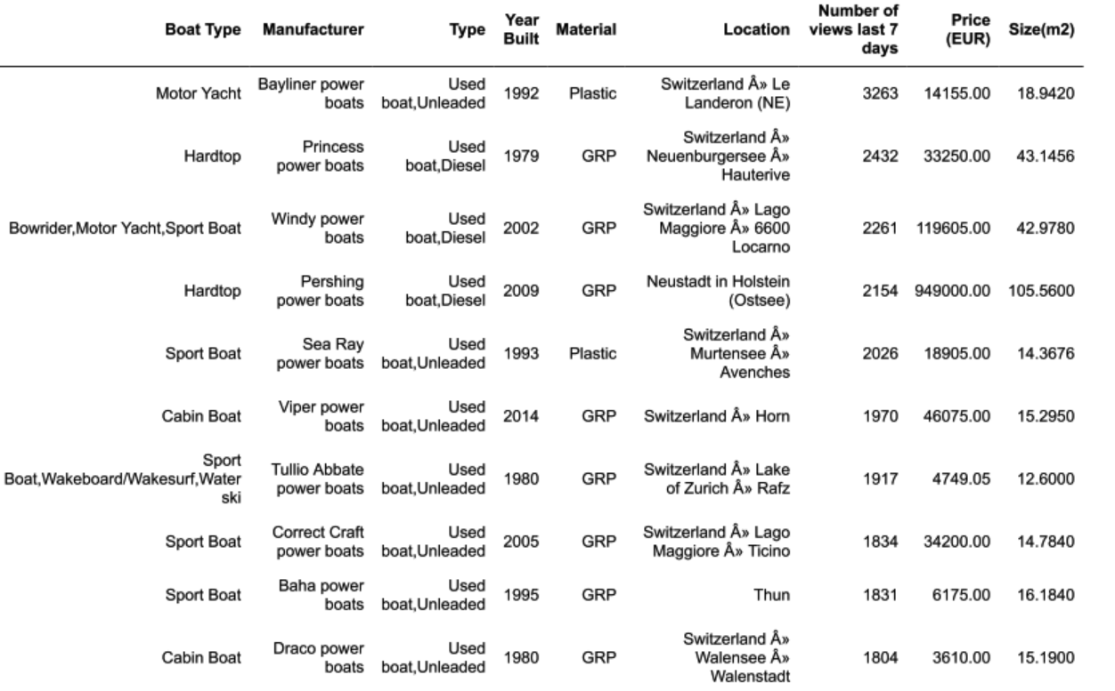
TOP 10 BOATS BY VIEWS

Slide 4
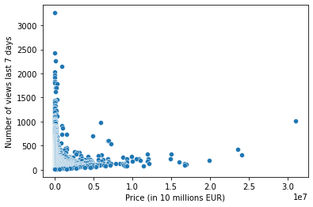
RELATION OF BOAT PRICE AND NUMBER OF VIEWS
Boat with price less than 1 million euros has larger views

Slide 5
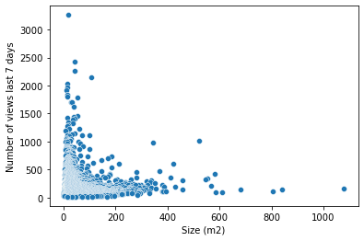
RELATION OF BOAT SIZE AND NUMBER OF VIEWS
Boat with size less than 100 m² has larger views

Slide 6
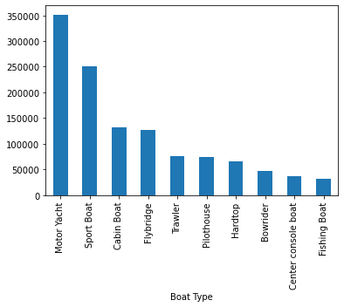
TOP 10 BOAT TYPE BY VIEWS
View

Slide 7
CONCLUSION
Boat with type motor yacht has the largest views followed by sport boat
In the top 10 boats by views, 7 boats are used boat and use unleaded gasoline
In the top 10 boats by views, 8 boats are made by GRP material
In the top 10 boats by views, 8 boats are located in Switzerland
Boat with price less than 1 million euros has larger views
Boat with size less than 100 m² has larger views

